Slide 1

Course code: CHM 122
Course Title: Introductory Organic Chemistry
Course Unit: (2 Units)
Module 2: Nomenclature, Classes and chemistry of organic compounds
Dr. AYOMIDE HASSAN, LABULO
DEPARTMENT OF CHEMISTRY
FEDERAL UNIVERSITY OF LAFIA

Slide 2
What are Organic Compounds?
• The compounds in solid, liquid or gaseous state which contain carbon in their molecules are known as organic compounds. • There are a large number of organic compounds and therefore a proper systematic classification was required. • Organic compounds can be broadly classified as acyclic (open chain) or cyclic (closed chain). • Let’s move on to their classification in detail.

Slide 3
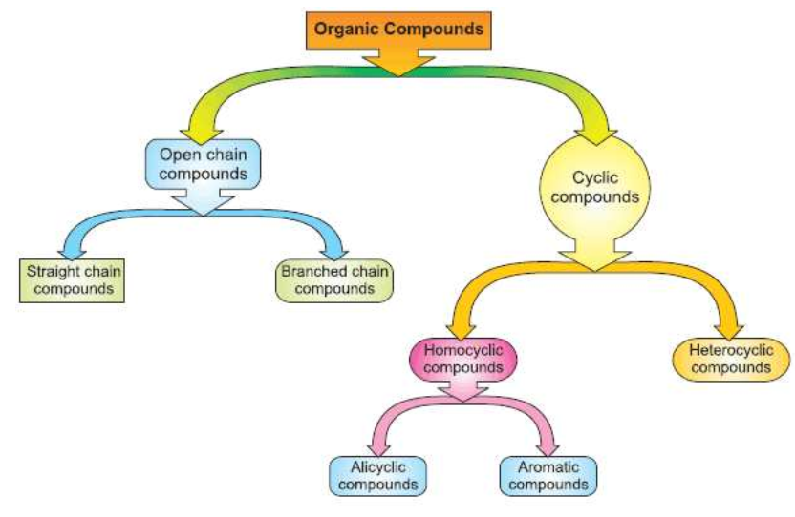
Acyclic or Open Chain Compounds
• These compounds are also known as aliphatic compounds, they have branched or straight chains.
• Following are the examples in this category.

Slide 4
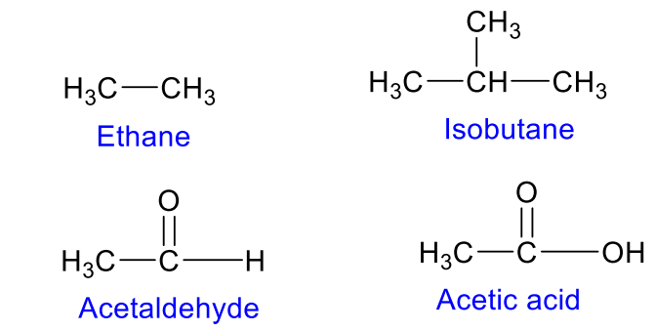
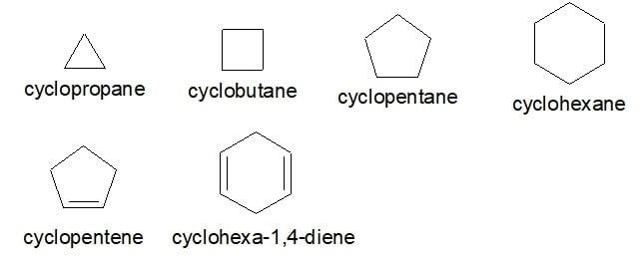
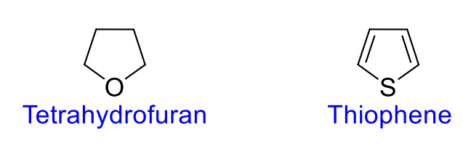
Classification of organic compounds
Two main types: acyclic and cyclic.
Acyclic compounds are those that have open chains of carbon atoms, which may be straight or branched.
Alicyclic (Homocyclic) Compounds • These are cyclic compounds which contain carbon atoms connected to each other in a ring. Examples of this type are as follows: .
Heterocyclic Compounds • These are cyclic compounds which contain atoms other than carbon in the ring. Examples of this type are as follows:

Slide 5
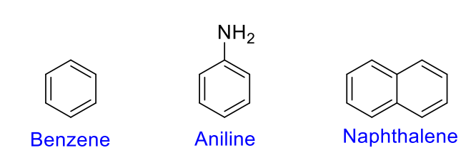
Aromatic Compounds
• They are a special type of compounds which contain benzene and other ring related compounds.
• Similar to alicyclic, they can also have heteroatoms in the ring.

Slide 6
IUPAC Nomenclature of Organic Compounds
IUPAC Nomenclature • In chemical nomenclature, the IUPAC nomenclature of organic chemistry is a method as recommended by the International Union of Pure and Applied Chemistry (IUPAC).
• Ideally, every possible organic compound should have a name from which an unambiguous structural formula can be created.
Basic Principles of IUPAC Nomenclature
In chemistry, a number of prefixes and suffixes are used to describe the type and position of functional groups in the compound.
• The steps for naming an organic compound are as follows.

Slide 7
Basic Principles of IUPAC Nomenclature
1. Identification of the parent hydrocarbon chain. This chain must obey the following rules, in order of precedence:
– It should have the maximum length. – It should have the maximum number of substituents of the suffix functional group. By suffix, it is meant that the parent functional group should have a suffix. – It should have the maximum number of multiple bonds. – It should have the maximum number of single bonds.

Slide 8
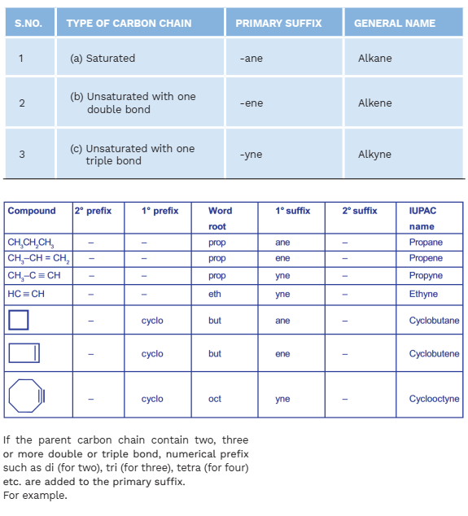
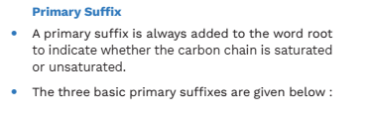
2. Identification of the parent functional group, if any, with the highest order of precedence. 3. Identification of the side-chains. Side chains are the carbon chains that are not in the parent chain but are branched off from it. 4. Identification of the remaining functional groups, if any, and naming them by their ionic prefixes (such as hydroxy for -OH, oxy for =O, etc.).

Slide 9
Basic Principles of IUPAC Nomenclature
Different side-chains and functional groups will be grouped together in alphabetical order. (The prefixes di-, tri-, etc. are not taken into consideration for grouping alphabetically.
For example, ethyl comes before dihydroxy or dimethyl, as the "e" in "ethyl" precedes the "h“ in "dihydroxy" and the "m" in "dimethyl“ alphabetically. The "di" is not considered in either case).

Slide 10
Basic Principles of IUPAC Nomenclature
5. Identification of double/triple bonds. 6. Numbering of the chain. This is done by first numbering the chain in both directions (left to right and right to left), and then choosing the numbering which follows these rules, in order of precedence.
✓ Has the lowest-number to the carbon to which the suffix substituent is directly attached. ✓ Has the lowest-number to the carbon attached to suffix multiple bonds ✓ Has the lowest-numbers to substituents for prefixes. 1

Slide 11
Basic Principles of IUPAC Nomenclature
7. Numbering of the various substituents and bonds. If there is more than one of the same type of substituent/double bond, a prefix is added showing how many there are ( di – 2, tri – 3 tetra – 4 and so on)
✓ If there are two side-chains with the same alpha carbon, the number will be written twice. Example: 2,2,3-trimethyl-………..
✓ When the main functional group is a terminal functional group (a group which can exist only at the end of a chain, like formyl and carboxyl groups), there is no need to number it. 1

Slide 12
Basic Principles of IUPAC Nomenclature
9. Addition of punctuation should be as under: ✓Commas are put between numbers (2 5 5 becomes 2,5,5) ✓Hyphens are put between a number and a letter (2 5 5 trimethylheptane becomes 2,5,5- trimethylheptane) ✓Successive words are merged into one word (trimethyl heptane becomes trimethylheptane)
Note: IUPAC uses one-word names throughout. This is why all parts are connected.

Slide 13
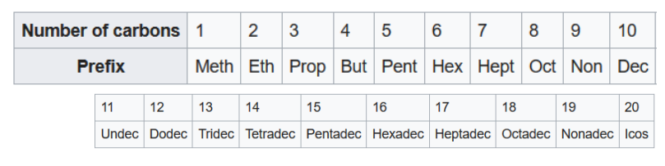
Basic Principles of IUPAC Nomenclature • The prefixes used in naming hydrocarbons are as follows:
Now we’ll discuss the nomenclature of different classes of organic compounds. • First of all, lets start with hydrocarbons.

Slide 14
IUPAC Nomenclature of Alkanes
• Straight-chain alkanes take the suffix "-ane" and are prefixed depending on the number of carbon atoms in the chain, following standard rules.
• For example, the simplest alkane is CH4 methane, and the nine-carbon alkane CH3(CH2)7CH3 is named nonane.
• Cyclic alkanes are simply prefixed with "cyclo-": for example, C4H8 is cyclobutane (not to be confused with butene) and C6H12 is cyclohexane (not to be confused with hexene)

Slide 15
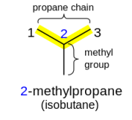
IUPAC Nomenclature of Alkanes • Branched alkanes are named as a straight-chain alkane with attached alkyl groups.
• They are prefixed with a number indicating the carbon the group is attached to, counting from the end of the alkane chain.
• For example, (CH3)2CHCH3, commonly known as isobutane, is treated as a propane chain with a methyl group bonded to the middle (2) carbon and given the systematic name 2-methylpropane.

Slide 16
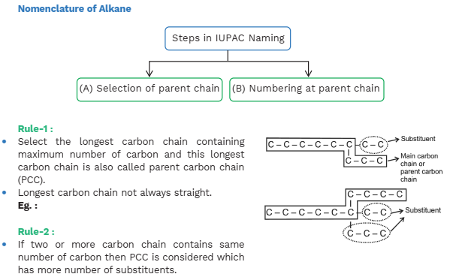

Slide 17
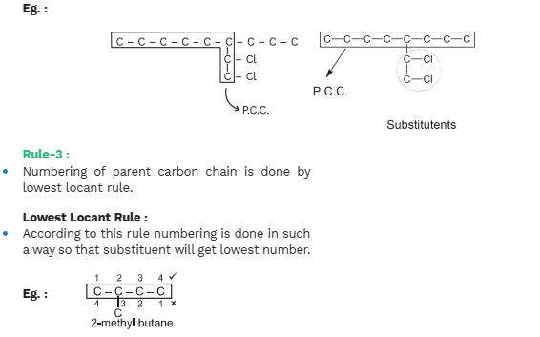

Slide 18
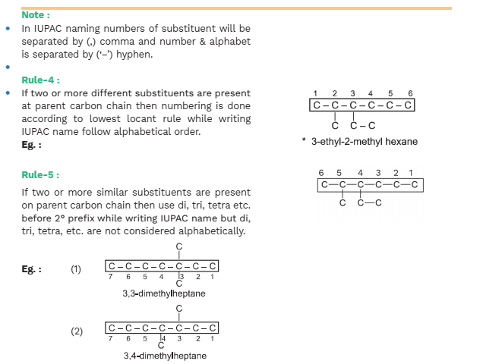

Slide 19
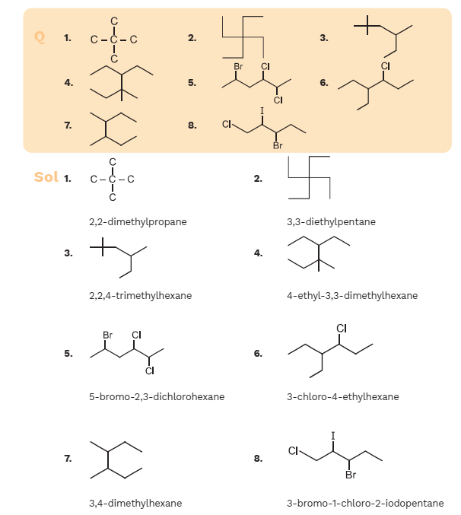

Slide 20
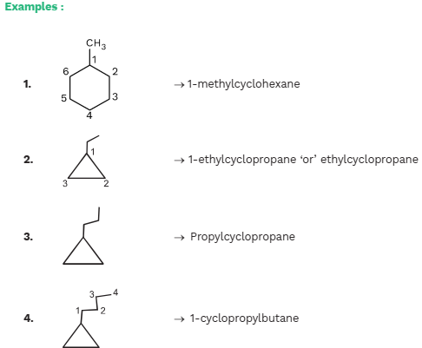
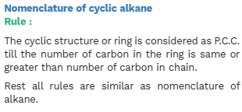

Slide 21
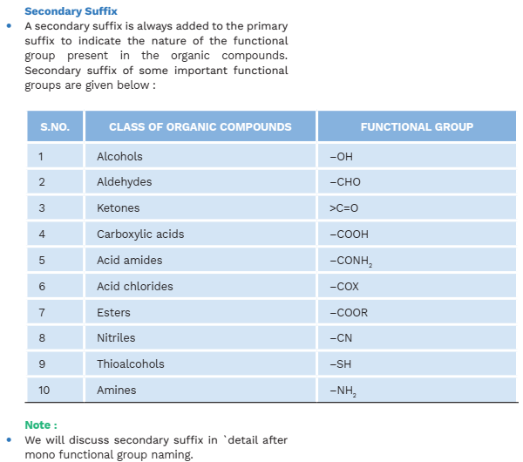

Slide 22
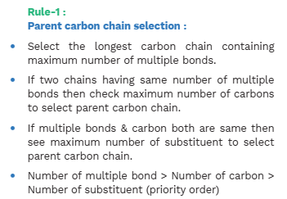
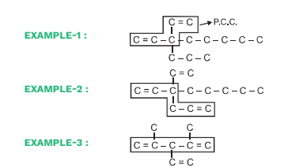
Nomenclature of Alkene and Alkyne

Slide 23
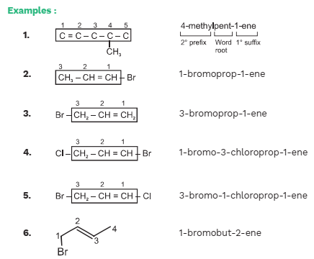
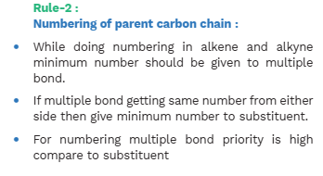

Slide 24
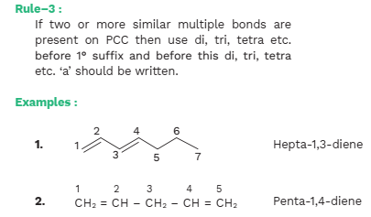
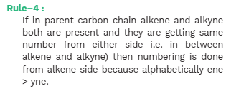

Slide 25
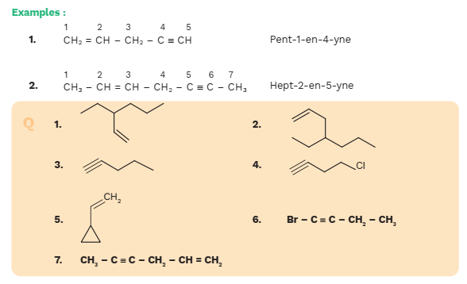


Slide 26
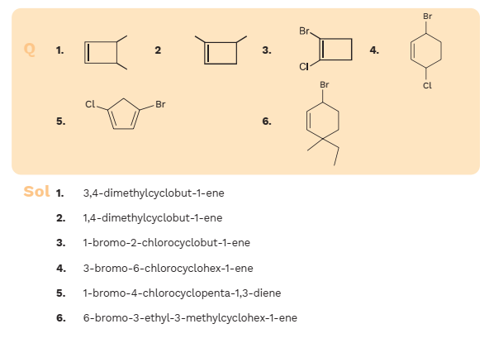
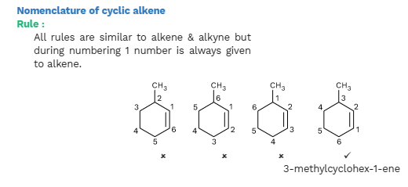

Slide 27
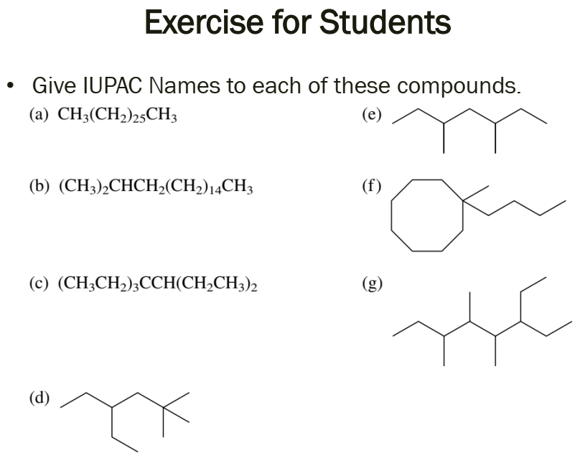

Slide 28
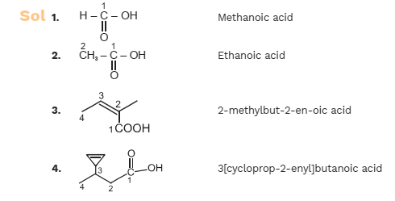
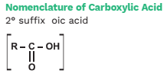
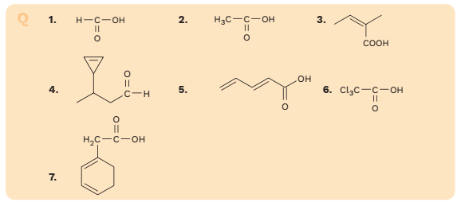
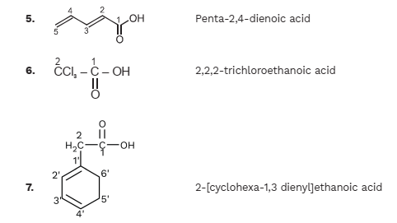

Slide 29
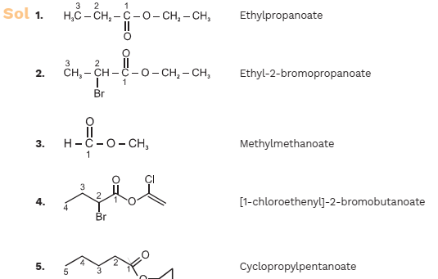
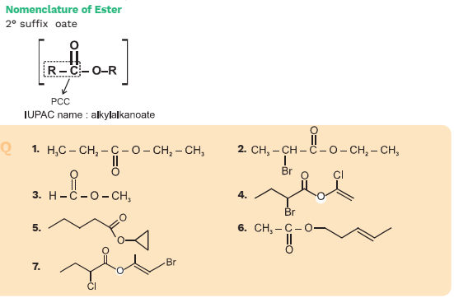
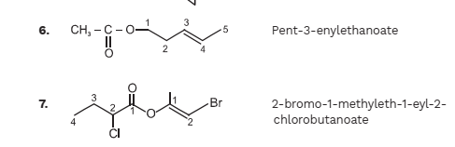

Slide 30
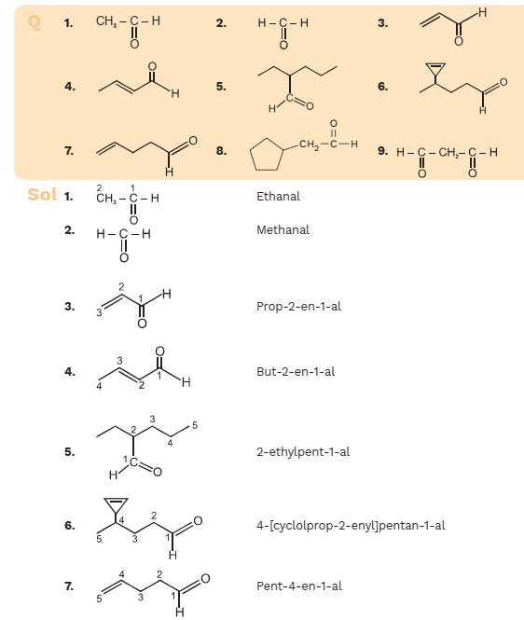


Slide 31
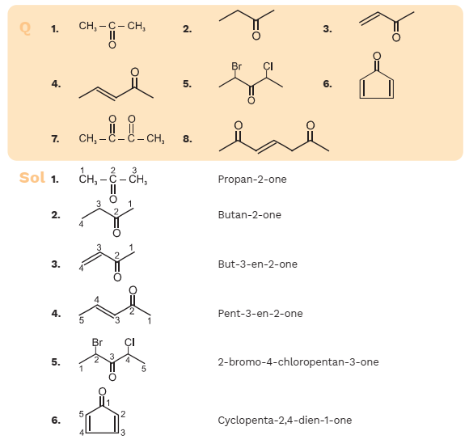


Slide 32
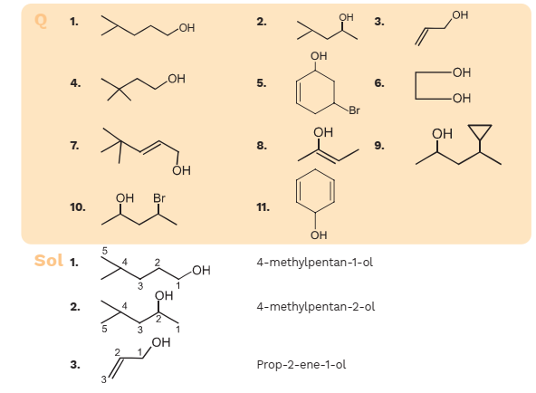
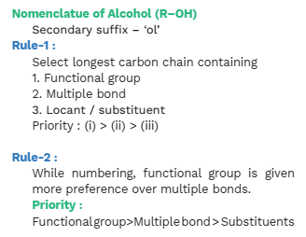

Slide 33
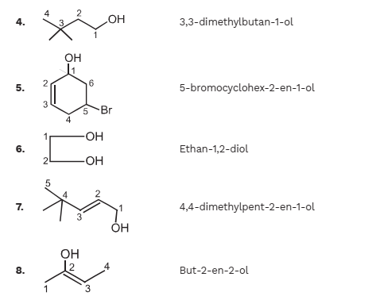
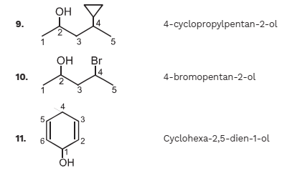

Slide 34
